Slide 1

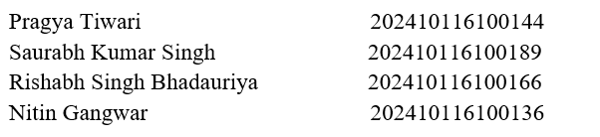
AI-I (AI101B) Even Semester Session 2024-25
PREDICTING HEART DISEASE
Submitted By:
Project Supervisor:
Mrs. Komal Salgotra
Notes:
“Good morning everyone! We are here to present our project on Healthcare Data Cleaning which focuses on how clean data can dramatically improve the healthcare industry.”

Slide 2

Predicting Heart Disease with AI
Revolutionizing healthcare with machine learning models to predict heart disease early. This project leverages Random Forest and Artificial Neural Networks for impactful diagnosis.

Slide 3

The Challenge: Heart Disease
Global Impact
Leading cause of death globally, approx. 17.9 million deaths yearly.
Detection Importance
Early detection is key to effective treatment and prevention.
Limitations
Traditional diagnostics can be slow and sometimes inaccurate.
Opportunity
AI offers faster, more precise prediction methods for heart disease.

Slide 4
Our Approach: Machine Learning
Supervised Learning
Feature Selection
Algorithms
Goal
Models trained on labeled patient data to predict outcomes.
Focus on key risk factors influencing heart disease prediction.
Random Forest
Create an accurate, reliable predictive model.
Artificial Neural Networks (ANNs)

Slide 5
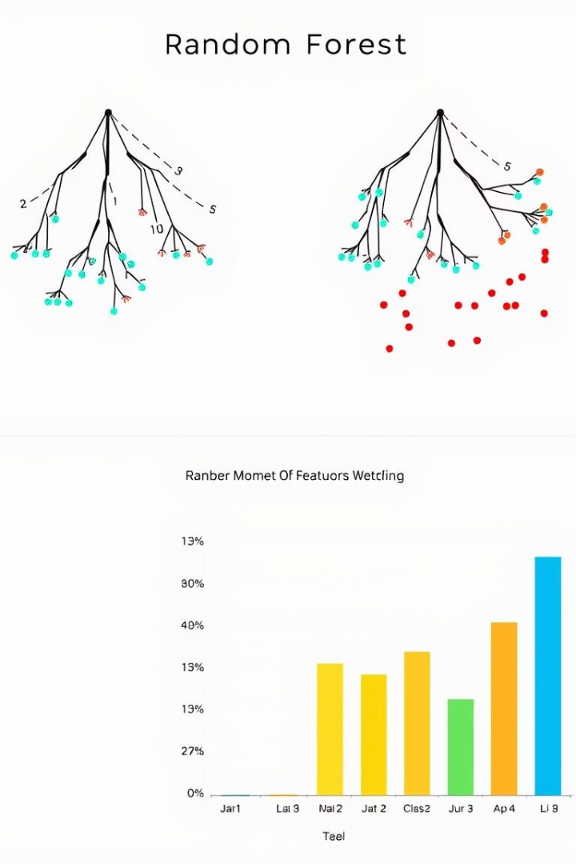
Algorithm 1: Random Forest
Ensemble Learning
Combines multiple decision trees for robust predictions.
Overfitting Resistant
Maintains high accuracy with strong generalization to new data.
Feature Importance
Identifies key factors affecting heart disease risk.
Example Metric
Mean Decrease in Gini Coefficient measures feature influence.

Slide 6
Algorithm 2: Artificial Neural Networks (ANN)
Brain-Inspired Model
Deep Learning
Feature Learning
Activations
Multiple layers capture complex patterns in data.
Automatically discovers hidden relationships in features.
Uses ReLU and Sigmoid functions for non-linear transformations.
Interconnected nodes simulate how neurons process information.

Slide 7
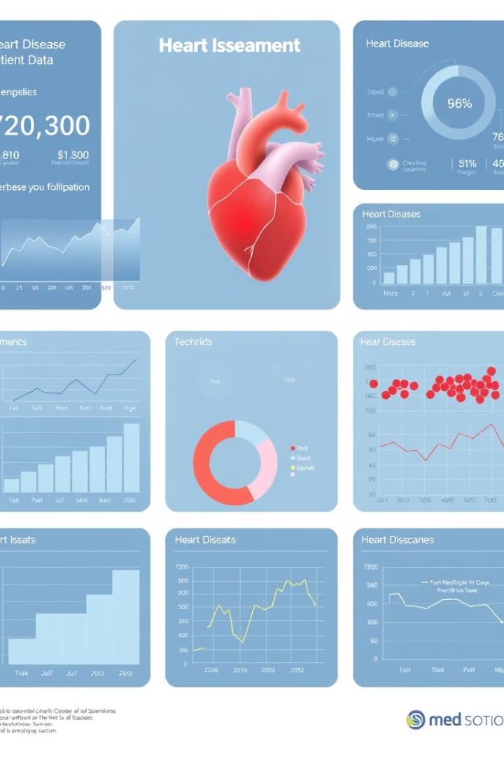
Data and Features
Dataset
Utilizes Kaggle Heart Disease Dataset with comprehensive patient records.
Dataset Size
Over 1,000 patients with 13+ clinical features each.
Key Features
Age, Sex
Cholesterol, Blood Pressure
ECG results and other factors
Preprocessing
Data cleaning and normalization to improve model quality.

Slide 8
Results and Performance
Evaluation Metrics
Random Forest
Artificial Neural Networks
Comparison
Accuracy
Achieved 85% accuracy on test data.
ANN beat Random Forest by 4%, showing better pattern learning.
Precision
Outperformed with 89% accuracy.
Recall
F1-Score, AUC-ROC

Slide 9





Conclusion and Future Directions
Conclusion
AI significantly boosts early heart disease diagnosis accuracy.
Next Steps
Deploy models in clinical settings and collect real-time feedback.
Further Research
Expand datasets and explore advanced ML techniques.
Ultimate Goal
Save lives through fast, accurate, AI-enabled heart disease detection.

